Slide 1
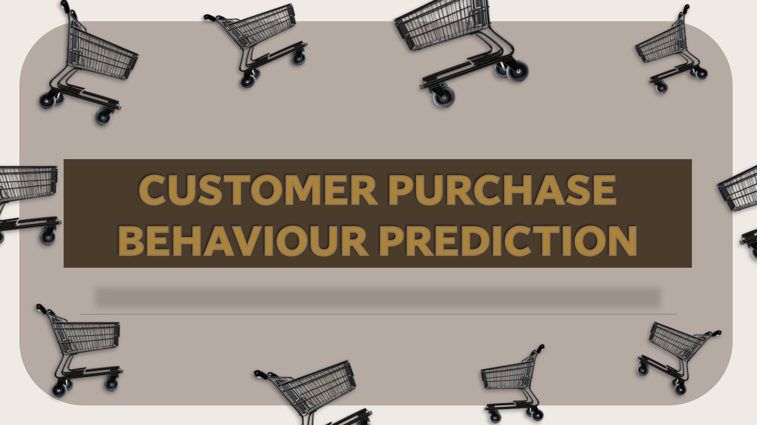

Slide 2
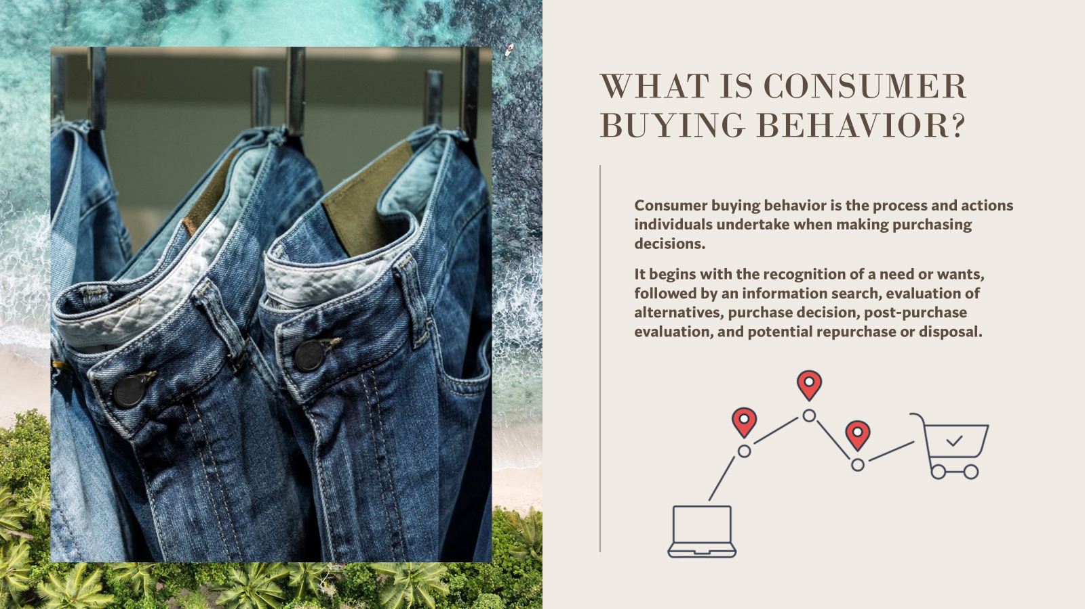

Slide 3
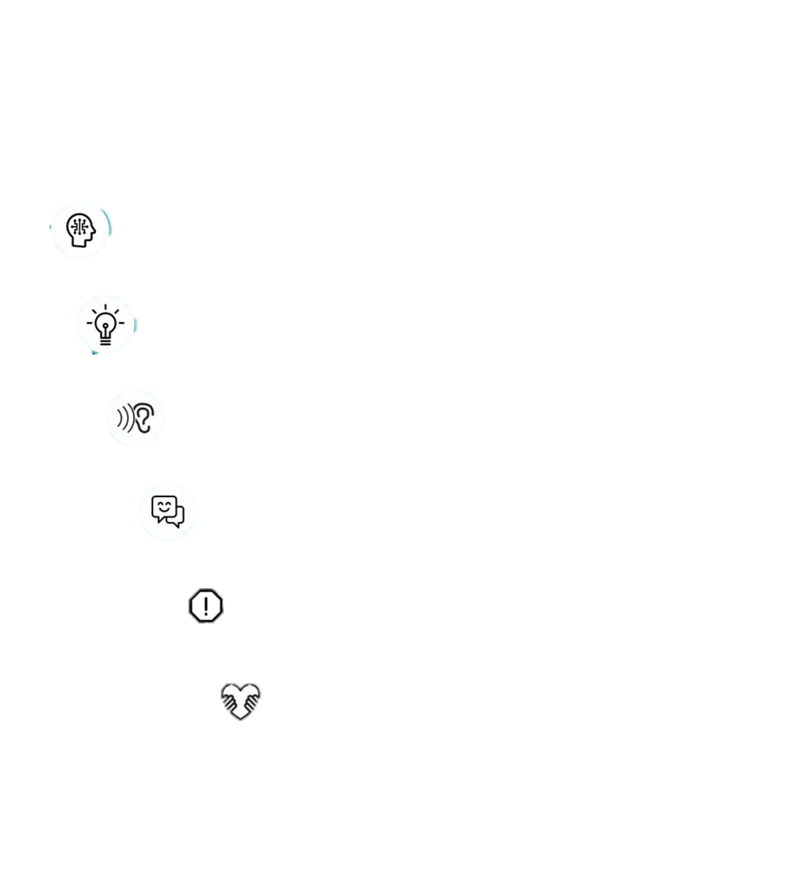

IMPORTANCE OF STUDYING CONSUMER BEHAVIOR
Comprehending consumer needs
Fabricating effective marketing strategies
Identifying market opportunities
Enhancing customer experience
Minimizing risks and failures
Building strong brand relationships

Slide 4

PROJECT OBJECTIVE
The objective of this project is to develop a machine learning model that can predict whether a customer will make a purchase based on various demographic and behavioural features. The model will be trained on historical customer data and will aim to provide accurate predictions to support business decision-making processes.

Slide 5
DATASET OVERVIEW
• Age: Customer's age
• Gender: Customer's gender (0: Male, 1: Female)
• Annual Income: Annual income of the customer in dollars
• Number of Purchases: Total number of purchases made by the customer
• Product Category: Category of the purchased product
(0: Electronics, 1: Clothing, 2: Home Goods, 3: Beauty, 4: Sports)
• Time Spent on Website: Time spent by the customer on the website in minutes
• Loyalty Program: Whether the customer is a member of the loyalty program (0: No, 1:Yes)
• Discounts Availed: Number of discounts availed by the customer (range: 0-5)
• Purchase Status: Likelihood of the customer making a purchase (0: No, 1: Yes)

Slide 6

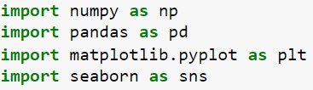
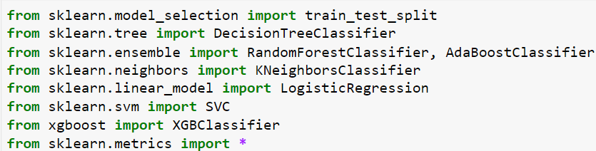
IMPORTED LIBRARIES

Slide 7
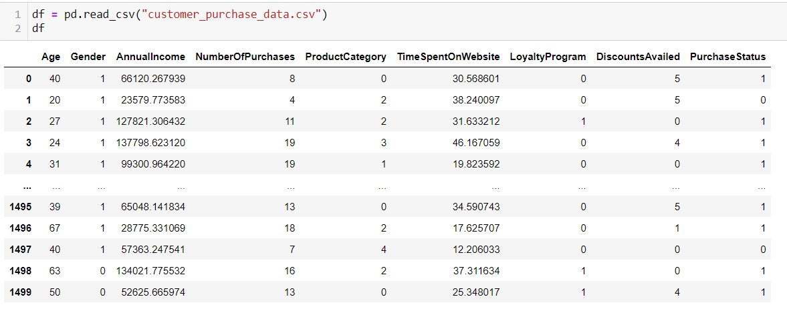
READING THE DATASET

Slide 8
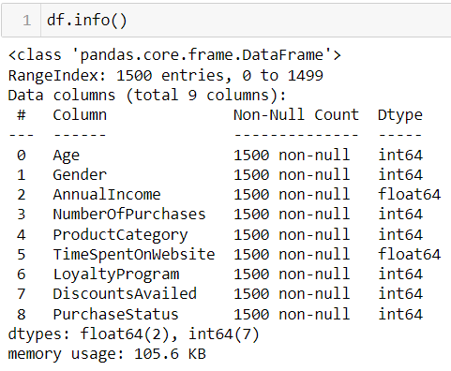
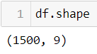
DATA SUMMARY
DATA SHAPE
1500 ROWS
9 COLUMNS

Slide 9
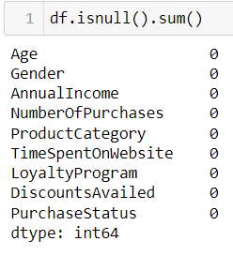
CHECKING NULL VALUES
There is no null value in this dataset.

Slide 10
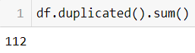
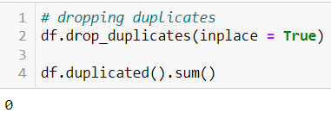
CHECKING AND DROPPING DUPLICATED VALUES
Total 112 duplicate values are found which are then dropped.

Slide 11
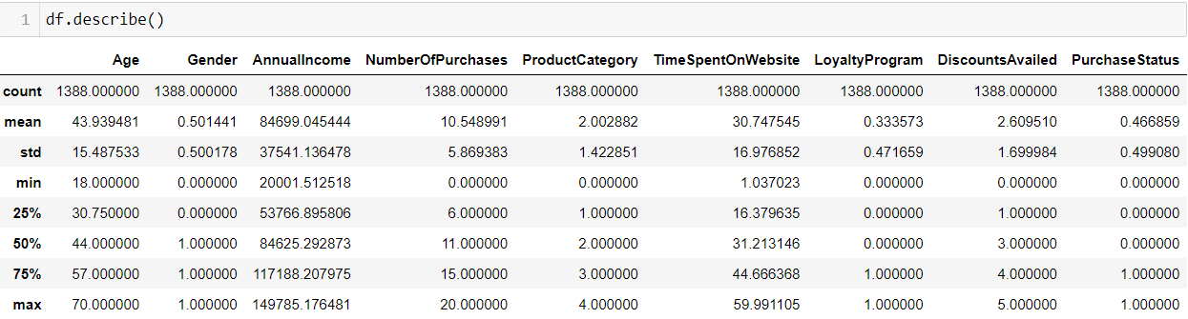
STATISTICAL DATA DESCRIPTION

Slide 12
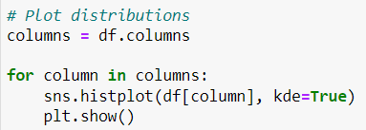
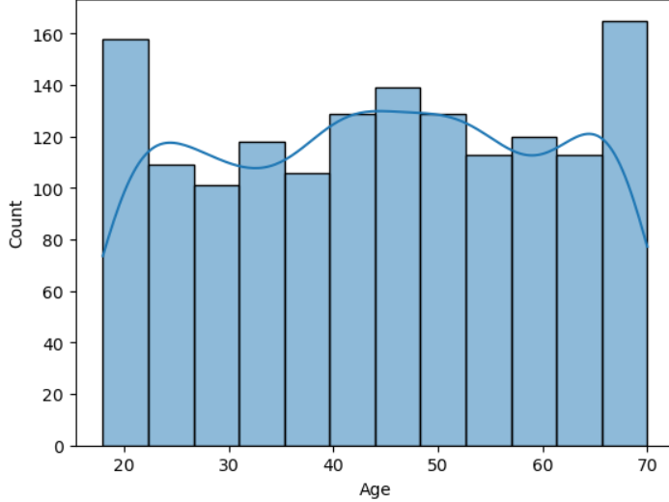
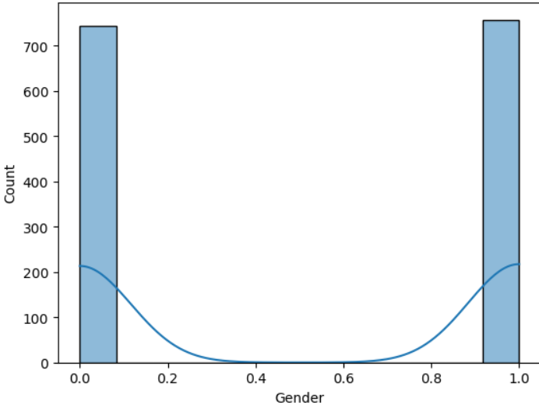
FEATURES DISTRIBUTION

Slide 13
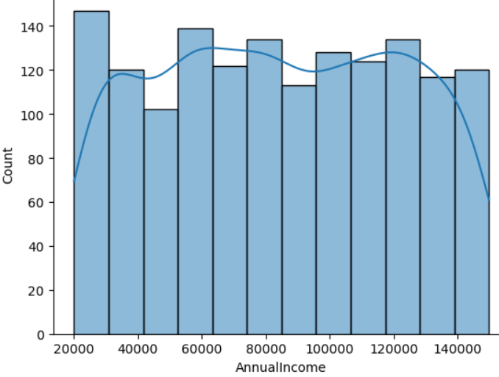
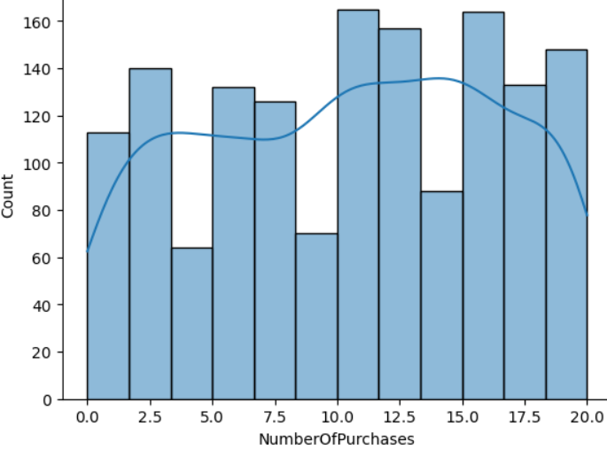
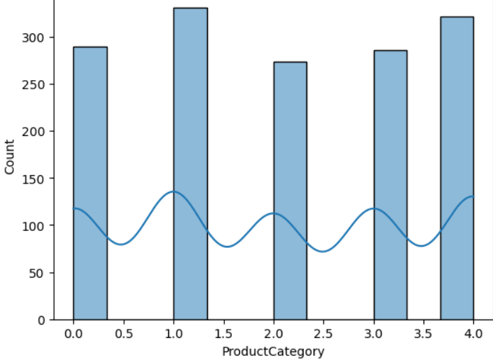
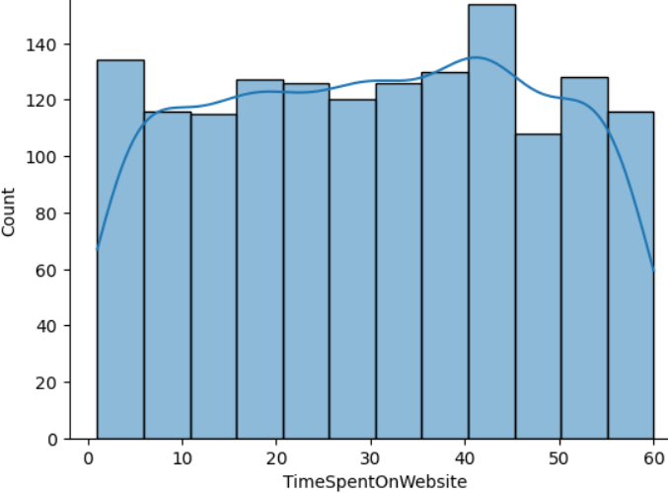

Slide 14
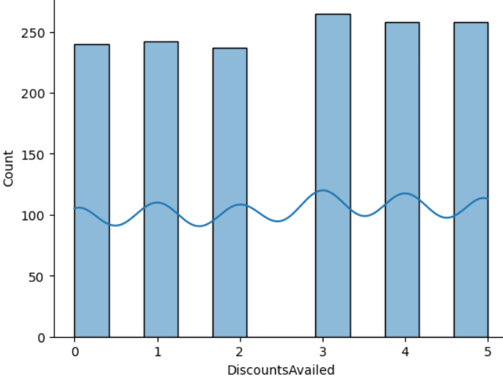
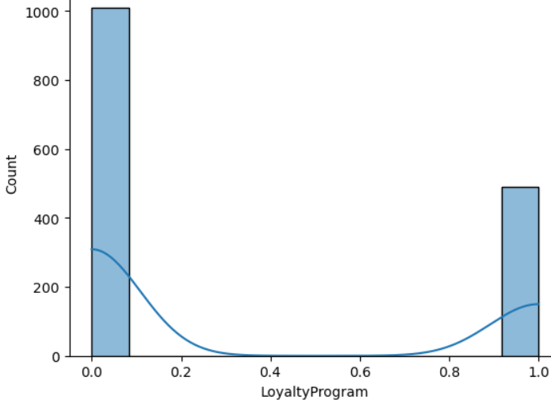
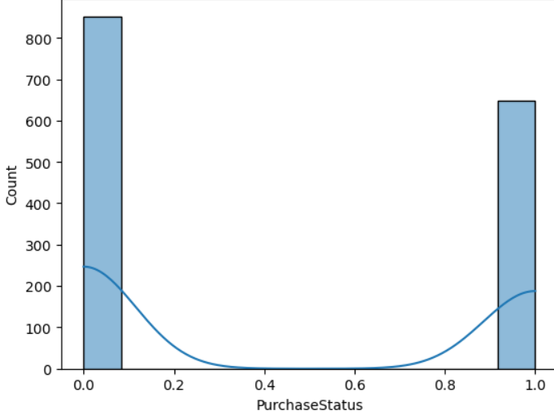

Slide 15
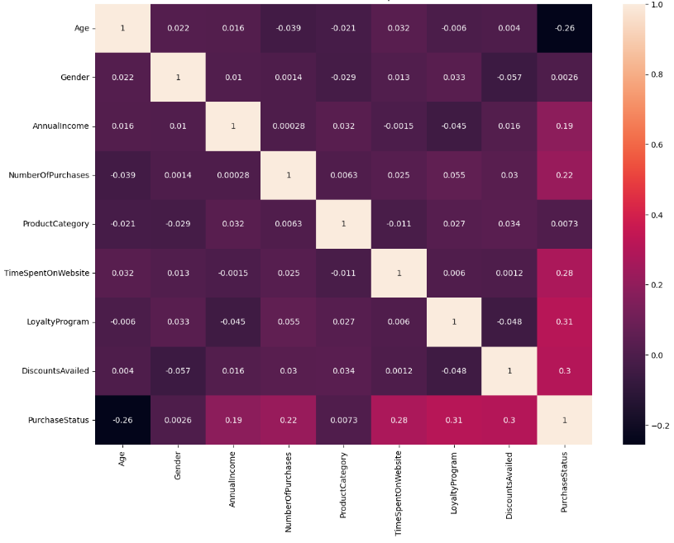
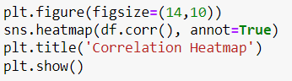
CORRELATION VIA HEAT PLOT

Slide 16
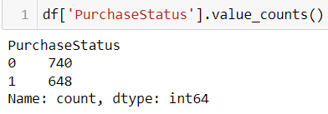
CHECKING IF DATA IS IMBALANCE OR NOT ?
The data is not imbalanced as the value count of Target Variable i.e, Purchase Status is in balanced range.

Slide 17
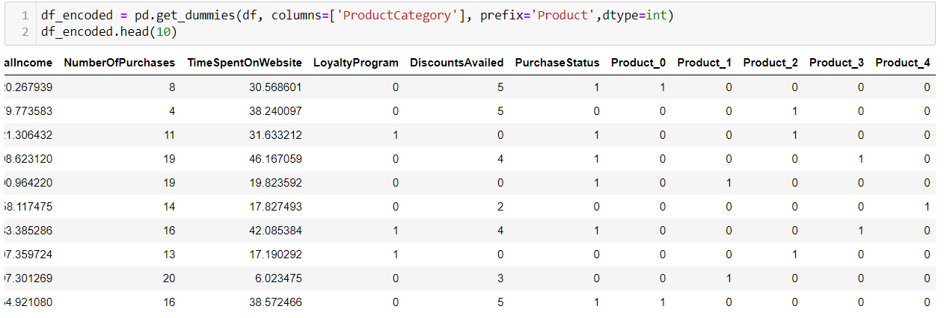
LABEL ENCODING
Encoded the Product variable which is a multi-classes variable.

Slide 18
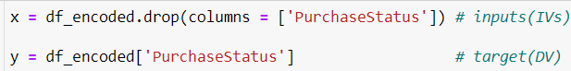
DEFINING DEPENDENT & INDEPENDENT VARIABLE
x : represents the independent variables.
y : represents dependent variable i.e, Purchase Status.

Slide 19
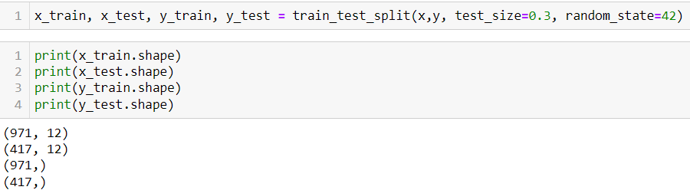
TRAIN - TEST SPLIT

Slide 20
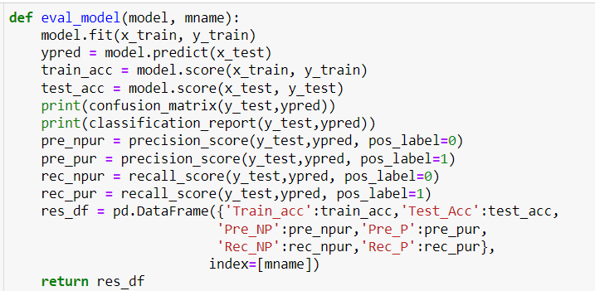
MODEL BUILDING
Defined a function to implement different models on the basis of this one function.

Slide 21
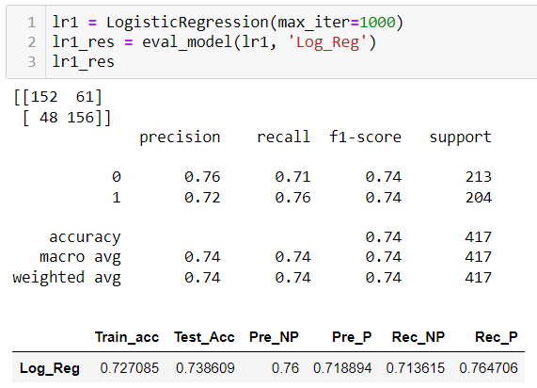
MODEL 1
LOGISTIC
REGRESSION

Slide 22
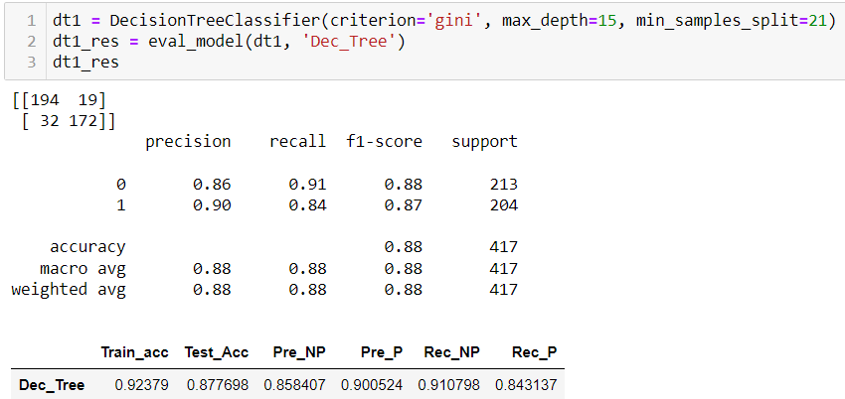
MODEL 2
DECISION
TREE
CLASSIFIER

Slide 23
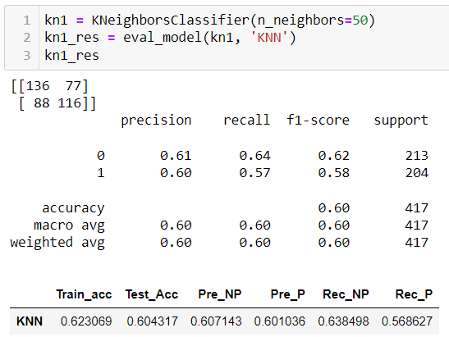
MODEL 3
KNN
CLASSIFIER

Slide 24
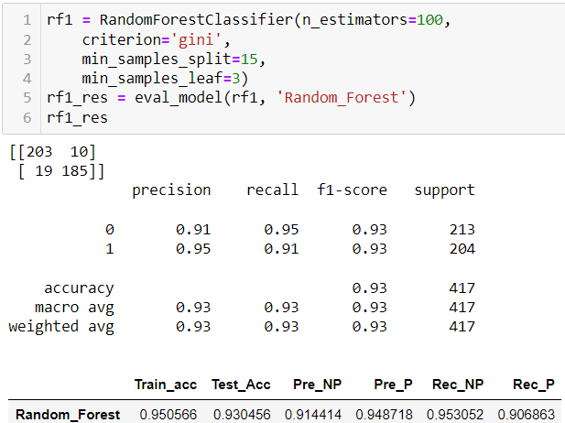
MODEL 4
RANDOM
FOREST
CLASSIFIER

Slide 25
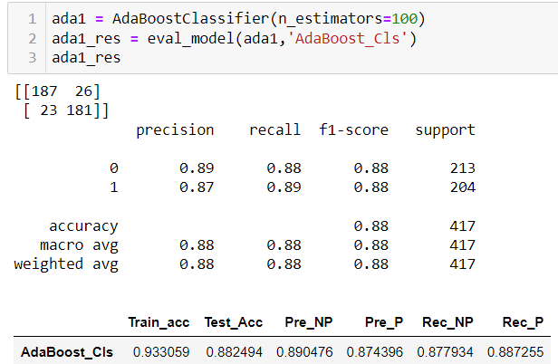
MODEL 5
ADA
BOOST
CLASSIFIER

Slide 26
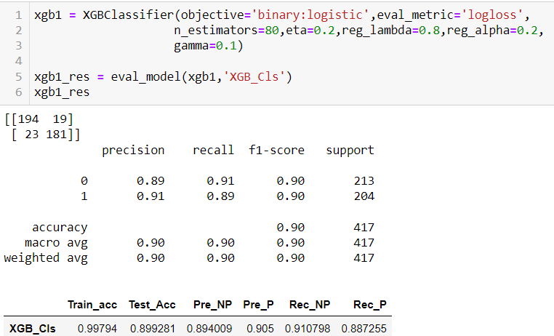
MODEL 6
XG BOOST
CLASSIFIER

Slide 27
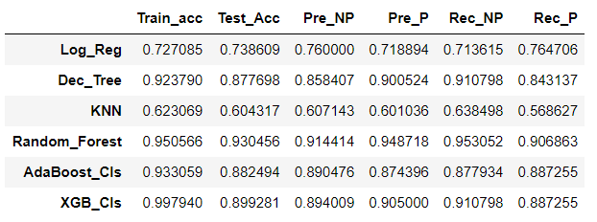
MODELS RESULT
RandomForestClassifier seems to be a strong candidate for this task due to its high accuracy and tendency to avoid overfitting compared to other algos. However, AdaBoostClassifier is also good choice and may offer better generalization.

Slide 28
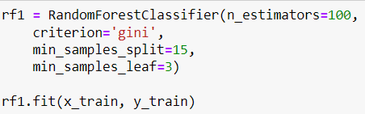
FINAL MODEL
RANDOM FOREST CLASSIFIER has worked best so we considered this as our final model to generate predictions.

Slide 29
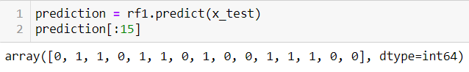
PREDICTIONS GENERATED
Predictions are generated on the basis of Random Forest Model

Slide 30
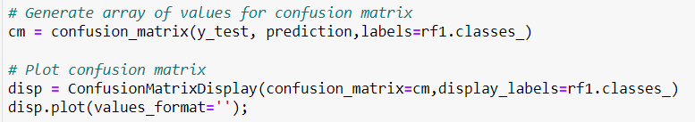
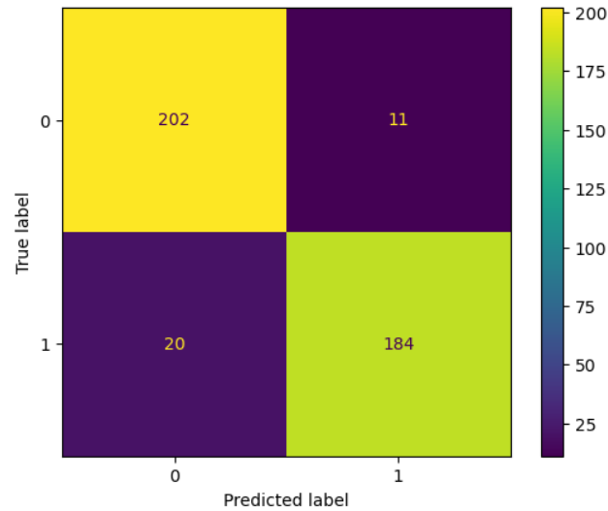
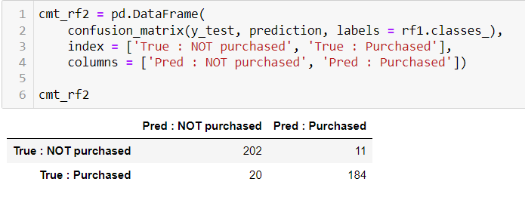
CONFUSION MATRIX

Slide 31
CONFUSION MATRIX DESCRIPTION
Upper-left quadrant displays the number of 0-0: True negatives.
Upper-right quadrant displays the number of 0-1: False positives.
Bottom-left quadrant displays the number of 1-0: False negatives.
Bottom-right quadrant displays the number of 1-1: True positives.
0-0: True negatives: The number of purchases that did NOT happen and the model accurately predicted "did NOT happen".
0-1: False positives: The number of purchases that did NOT happen and the model inaccurately predicted "did happen".
1-0: False negatives: The number of purchases that did happen and the model inaccurately predicted "did NOT happen".
1-1: True positives: The number of purchases that did happen and the model accurately predicted "did happen".
The Random Forest Model predicts more false negatives (20) than false positives (11), which means that more purchases may be identified as did not happened, while they are did. Regardless, this is a good model with strong scores.

Slide 32

ISHIKA JAIN
DATA ANALYST
Mail : ishikajain2032@gmail.com
LinkedIn: https://www.linkedin.com/in/ishikajain2/

